Slide 1
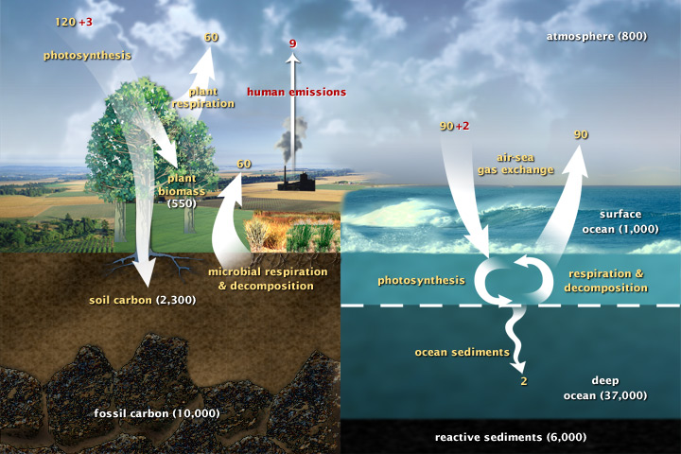

Slide 2
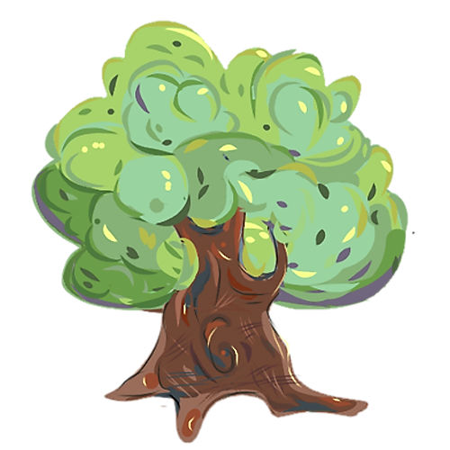


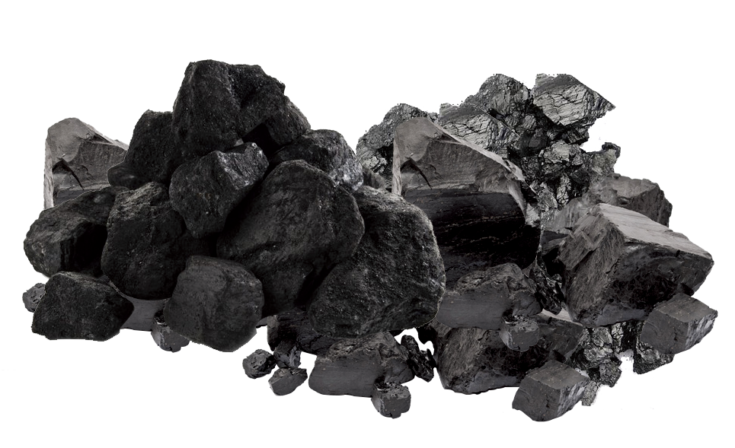

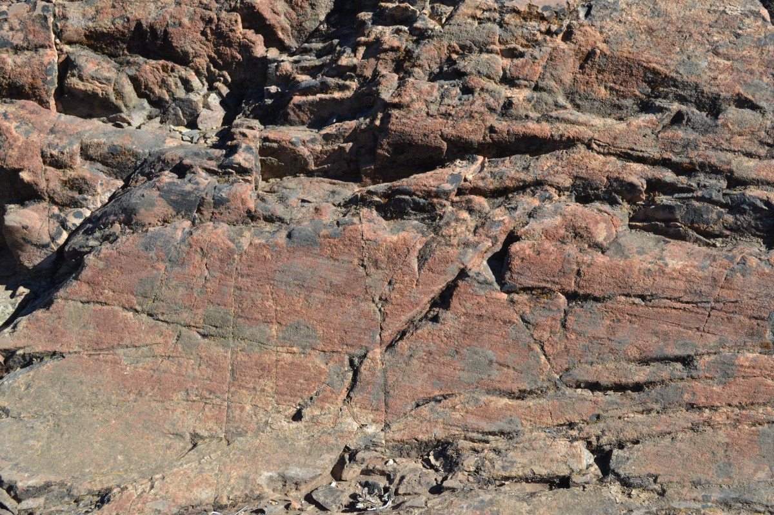
1,300 GtC
750 GtC
550 GtC
1,400 GtC
1,400 GtC
10,000 GtC
10,000 GtC

Slide 4
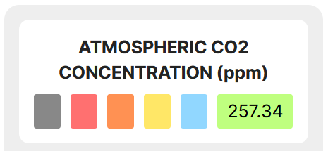
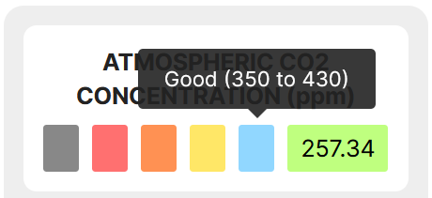


Slide 5

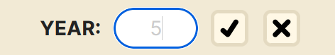
Play Pause Button
Text Box & Display
Reset Button
Confirm
Button
Cancel
Button

Slide 6
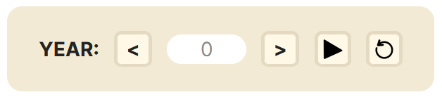
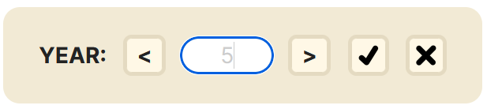
Cancel
Button
Play Pause Button
Text Box
& Display
Reset Button
Confirm
Button
Back
Button
Next
Button

Slide 7
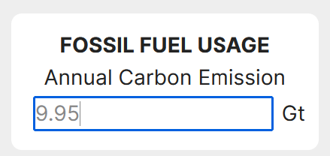
Text Box

Slide 8
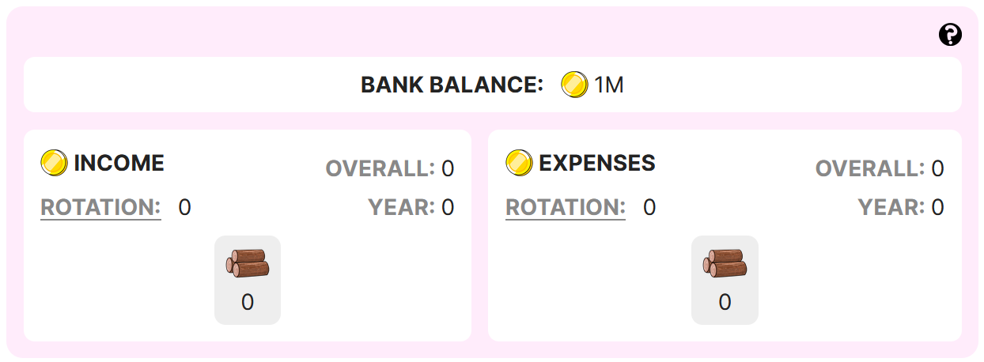

A Coin

Slide 9
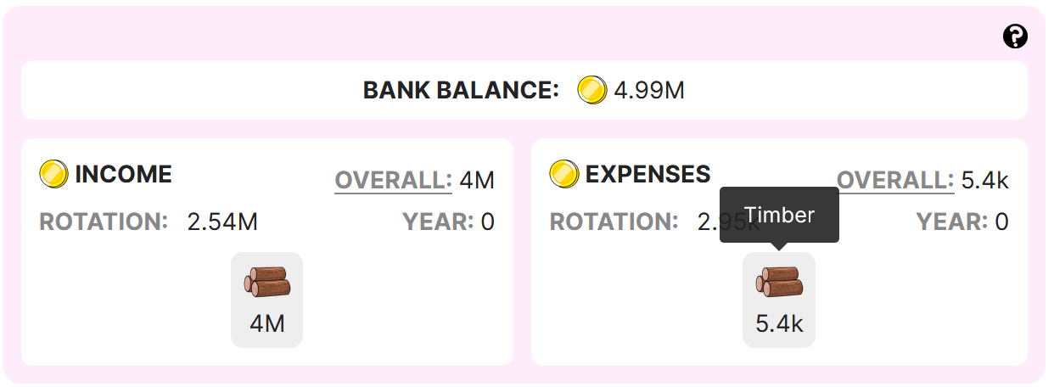



Slide 10
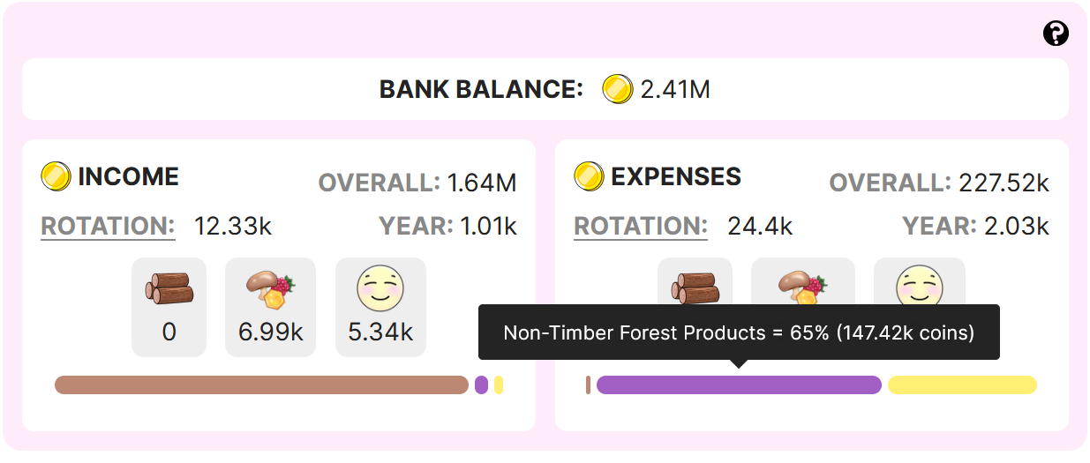

Slide 12
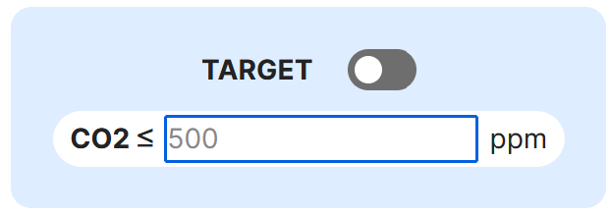
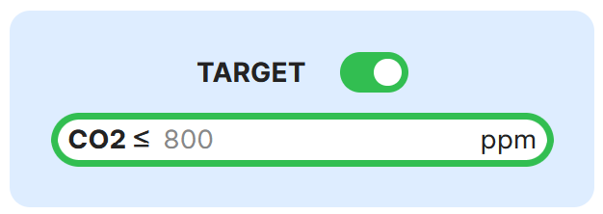
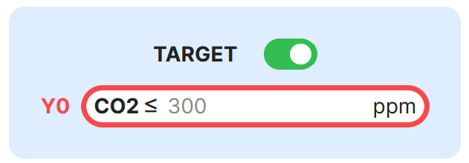
Success
Condition
View
Switch
Text Box
Target Met
Failed to meet target at year 0.

Slide 13
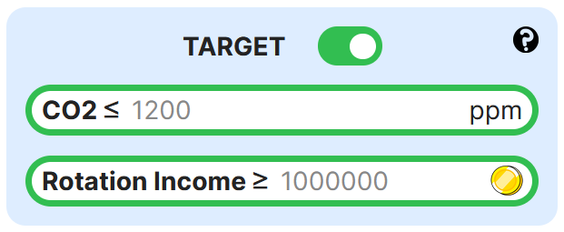
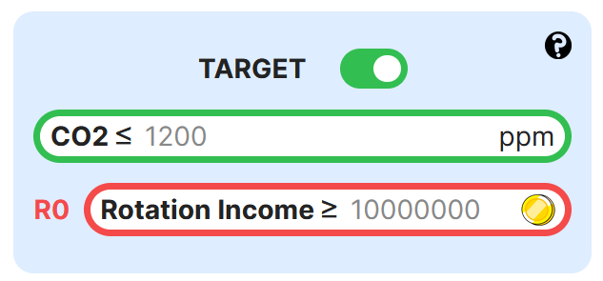

Slide 14



TIMBER
NTFP
RECREATION

Slide 15
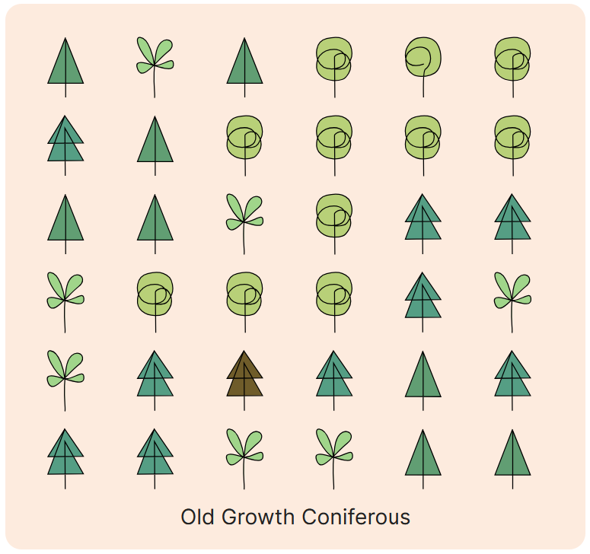

Slide 16










= Empty Land Spot
TREE LIFE STAGE
Age 1
Age 4
Age 21
Age 47
Age 70
Age 80
Deciduous
TREE TYPE
Coniferous
Age 1
Age 3
Age 26
Age 60
Age 90
Age 100
Old
Growth
Dead
Seedling
Sapling
Mature
Senescent

Slide 17
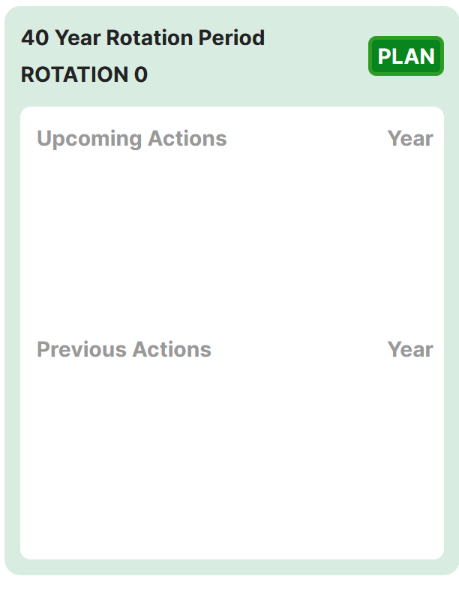
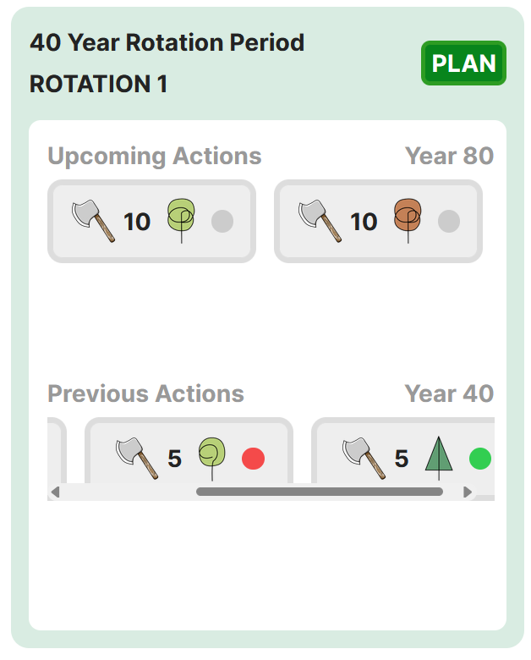
Rotation Period Display
Next Planned Actions with Year
Plan Button
Rotation Display
Last Processed Action(s) with Year

Slide 18
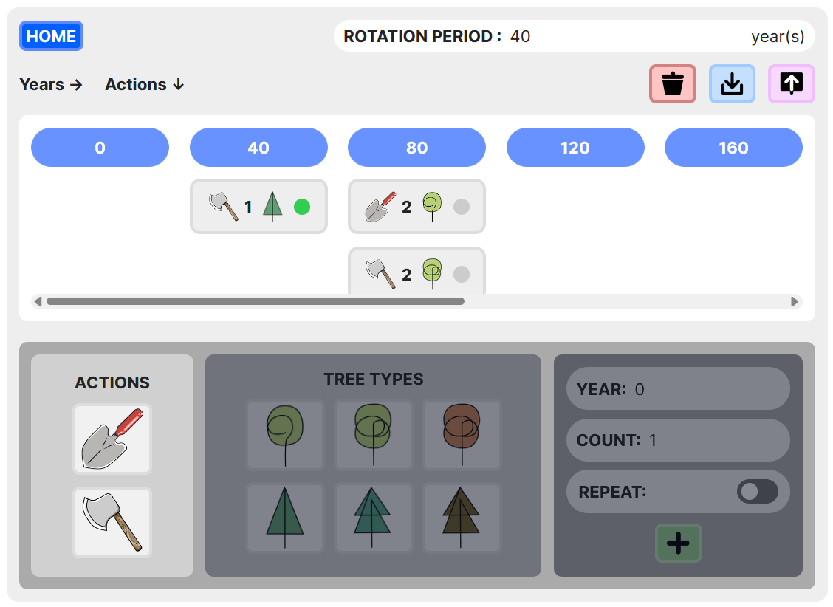
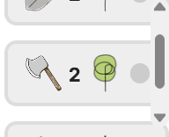
Rotation Period Display/Textbox
Save
Button
Home Button
Delete Button
Load
Button
Year Tag
Action Tag
Action
Picker

Slide 19
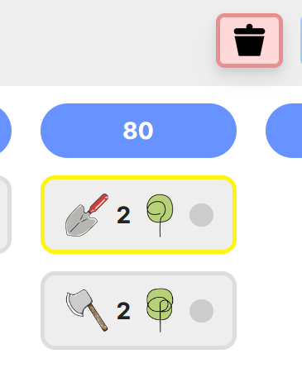
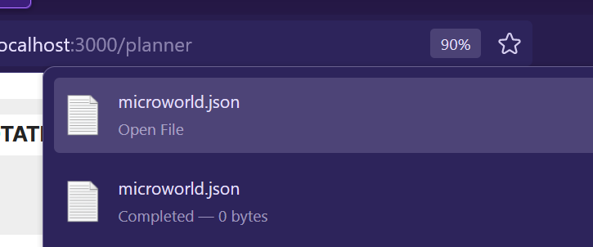
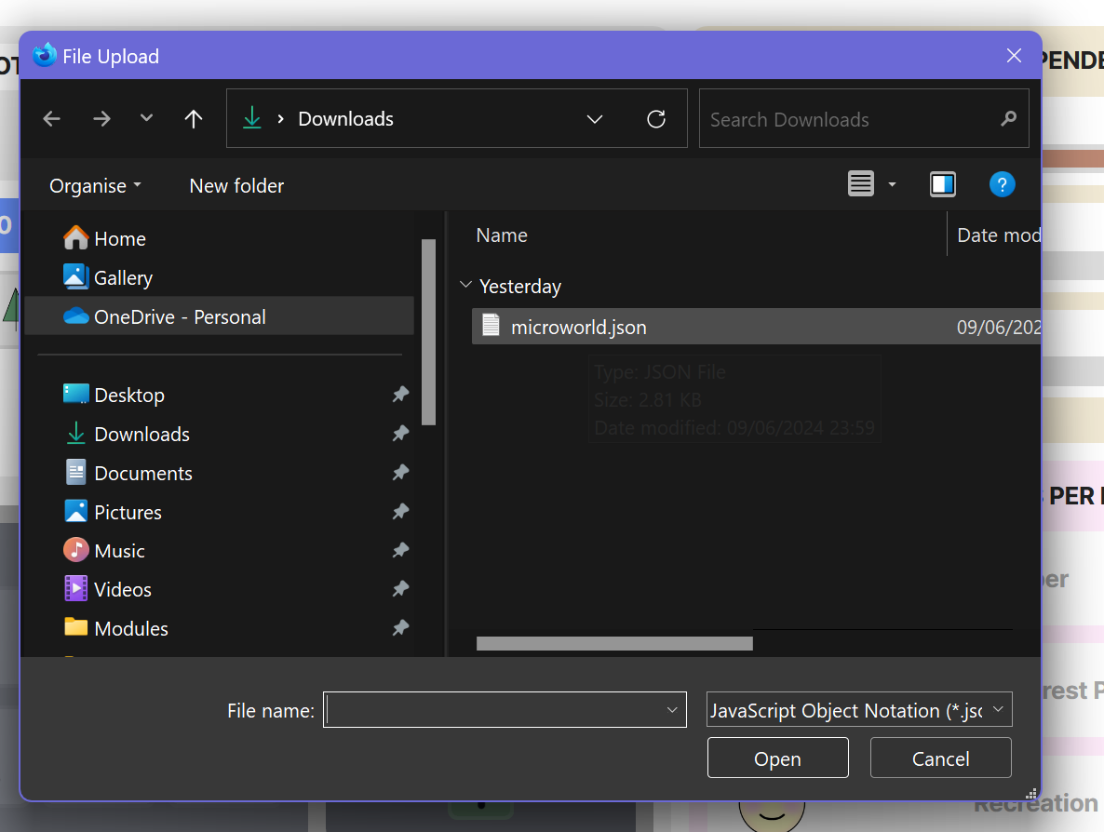
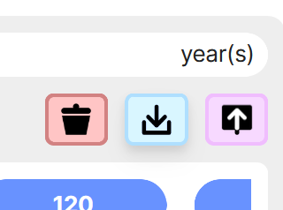
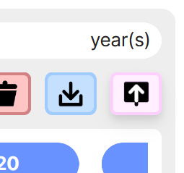
Delete Actions
Save Settings
Load Saved Settings

Slide 20
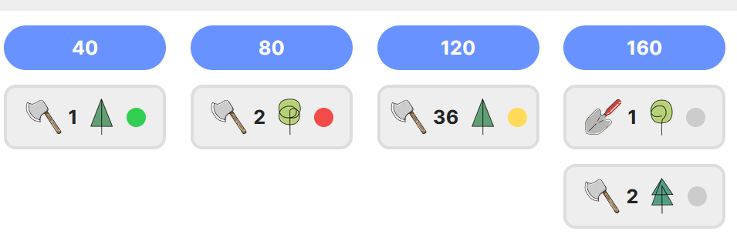
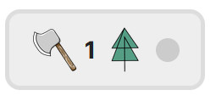
Tree Type
Action Type
Action Execution Status
Action could not be executed at all.
Maximum No. of trees to apply action to.
Action yet to be processed.
Action Successfully Executed for all planned no. of trees.
Action was executed for one or more trees as were available on land at year 120, but it could not be executed for all planned no. of trees.

Slide 21
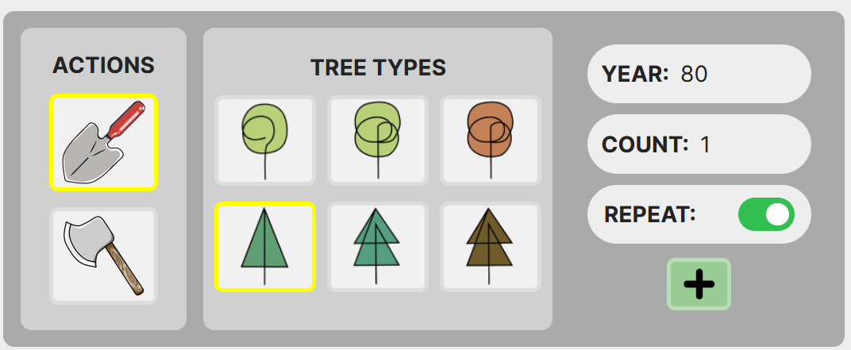
Year Text Box
Count Text Box
Repeat Switch
Action
Type Button
Tree Type Button
Add Button

Slide 22
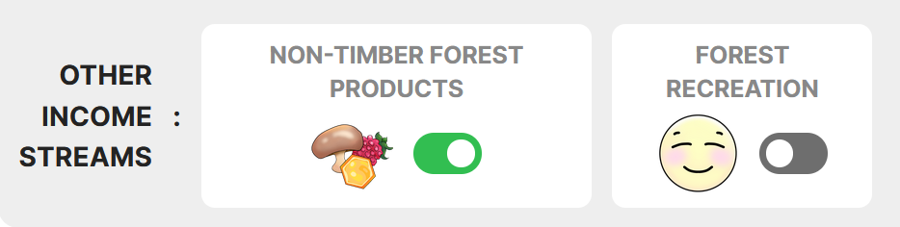
Dependency Switch

Slide 23
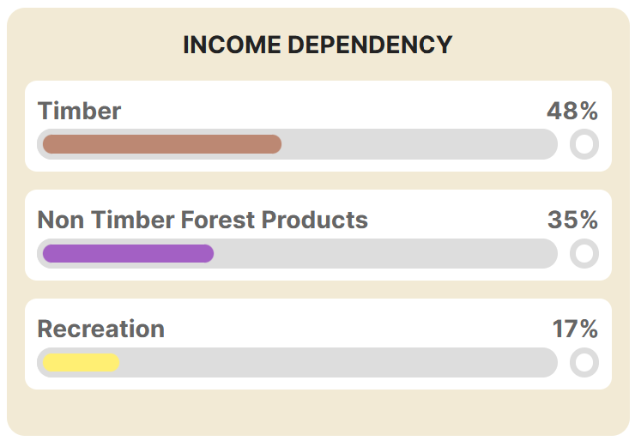
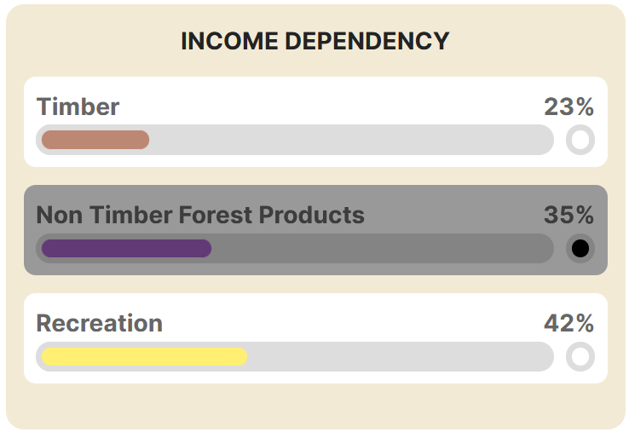
Slider Lock Toggle
Dependency Sliders

Slide 24
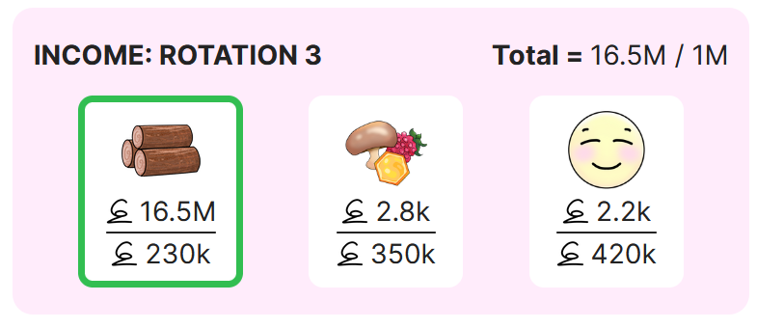
Current Rotation Display
Total/target income this rotation so far.
Income so far/expected income this rotation.

Slide 25
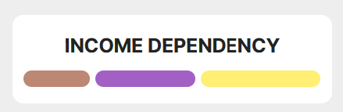
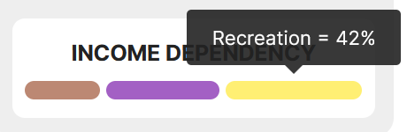

Slide 28
UI COMPONENTS
LANDING HELP HOME PLANNER
HOME
HOME
HOME
APP PAGES
SIMULATION MODEL
INPUT VARIABLES
UTILS

